Slide 2
Alfresco Content Services
Out-of-Process Extensions & ActiveMQ Administration
Greg Bousley
Angel Borroy
Alex Madon
Notes:
Welcome to the Alfresco Content Services Out-of-Process Extensions & ActiveMQ Administration.
Today, we are going to go Hands-on with ACS and ActiveMQ to get a better understanding of the Out-of-Process SDK and see how AMQ plays a role in ACS.
[If this is a stand-alone class, Introduce yourself.]
My name is Greg Bousley, and I’ll be your lead facilitator for this session.
I am an Instructional Designer and have the pleasure to work for Hyland for just over two years, where I have mostly focused on Alfresco.
With me today is Angel Borroy, who is here to lend his vast knowledge on the topic as well.
Also, Alex Madon joins us and will also present a demo of how you may administer Active MQ with a python platform.

Slide 3

ACS Out-of-Process Extension Project
https://github.com/GBHyland/
Notes:
Connect to the following github page. Select the alfresco-out-of-process-extension-with-ActiveMQ github project.
[ Launch Github page and review from there ]
https://github.com/GBHyland/alfresco-out-of-process-extension-with-activeMQ

Slide 4
Objectives
Define and recall ActiveMQ’s messaging services within Content Services for Community & Enterprise
Build an Out-of-Process SDK to consume ActiveMQ messages and perform actions
Notes:
By the end of this lesson, you should be able to:
Define and Recall the capabilities and actions that ActiveMQ performs within Content Services for both Community and Enterprise editions
Build an Out-of-process SDK, consume ActiveMQ messages, and perform repository actions.

Slide 5


What is ActiveMQ?
ActiveMQ is a Java-based message broker.
Used to handle event-driven communications between services
Search Services
Elasticsearch
Elasticsearch
Data Store
ActiveMQ
ActiveMQ
Data Store
Notes:
First, let us start with defining what Active MQ is?
Simply put, ActiveMQ is a Java-based message broker.
*CLICK*
In Alfresco, AMQ is used to handle event-driven communications between a number of Alfresco services. (the Repository, Transform, Search, and Sync services. (This is for enterprise version). )
*CLICK*
In the example snippet here, when search services are used, Elastic Search is engaged and that activity is sent to an Elastic Search data store.
*CLICK*
What’s also happening, is that the search data is also sent to an AMQ broker which stores its data into an AMQ data store.

Slide 6



ActiveMQ – What, How, Why?
Non-Containerized Deployment
Manual Installation (zip distribution)
Ansible Playbooks
Containerized Deployments
Docker Compose
Helm Charts (Kubernetes)
ActiveMQ is a broker service catching event communication between services.
The interaction happens by using asynchronous messaging queues and topics, where the services produce and consume events.
Utilizes asynchronous message queues increasing capacity to scale Alfresco & improve management of time-consuming operations.
Notes:
ActiveMQ is a broker service catching event communication between services.
*CLICK*
The interaction happens by using asynchronous messaging queues and topics, where the services produce and consume events.
*CLICK*
Utilizes asynchronous message queues increasing capacity to scale Alfresco & improve management of time-consuming operations.

Slide 7
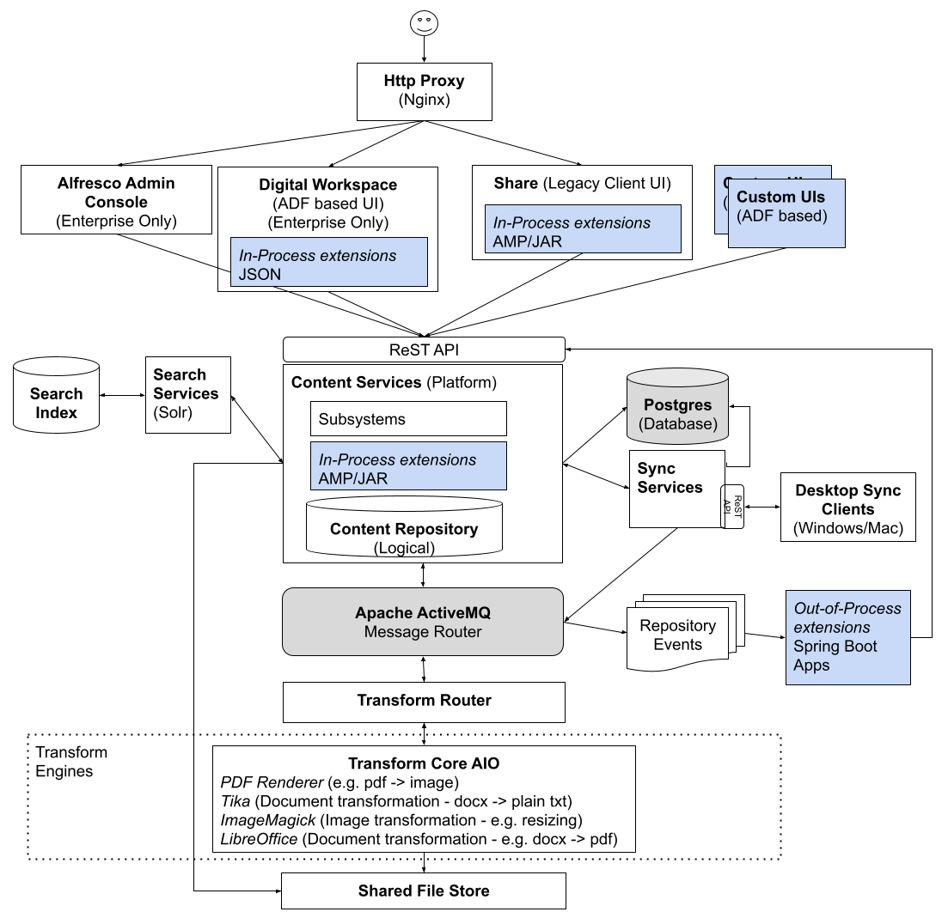
Architecture - ActiveMQ
Instance of Apache ActiveMQ server is installed during installation
Sits as a message broker between Repository and other components:
Transformation Service
(transformation requests from repo)
Sync Service
(folder & doc changes in repo)
Search Service
(listens to repo events)
External Extensions
(listens to repo events)
Notes:
When you install Content Services an instance of Apache ActiveMQ server is also installed.
*CLICK* It’s an integral part of Content Services and sits as a message broker between the Repository and several other components:
*CLICK* Transformation Service: receives messages about transformations that have been requested by the repository.
*CLICK* Sync Service: receives messages about folder and document changes in the repository
*CLICK* Search service is listening to repository events.
*CLICK* These extensions listen to the repository events and then execute code depending on what happened in the repository, such as file uploaded, folder created etc.
*CLICK* Notice the architecture of the Out-of-process extensions, This is the domain that we will be building our out-of-process extension in later activities. Notice how the message router sends data via repository events which engage Spring Boot applications. In our Hands-on activities we’ll create a spring boot app that will listen for repository events.

Slide 8
ActiveMQ – Topics vs Queues
Mssg
Topics:
Uses publish and subscribe behavior
Published messages route to all subscribers with active subscription
Only subscribers at time broker receives message will get a copy
Receiver
Receiver
Receiver
Queues:
Mssg
Uses load balancer behavior
Messages sent & received on 1:1 ratio
Sent messages are stored until a receiver is available
Messages are queued and load balanced across the available consumers
Load
Balancer
Receiver
Receiver
Receiver
Notes:
ActivMQ messages fall into two different categories: Topics and Queues.
*CLICK* In Java Messaging Service a Topic implements publish and subscribe behaviors.
*CLICK* Published messages are routed to all of the subscribers to that message.
*CLICK* One thing to note about this behavior, is that only subscribers with active subscription to the broker will get a copy of the message.
*CLICK* Now, let’s talk about Queues.
*CLICK* A Queue implements load balancer behaviors. In this behavior, a single message is received by one consumer, so there is a 1:1 ratio of sent messages and receivers.
*CLICK* If there are no consumers available at the time the message is sent it will be kept until a consumer is available that can process the message. *CLICK* A queue can have many consumers with messages load balanced across the available consumers. So, Queues implement a reliable load balancer in a Java Message Service.

Slide 9
ActiveMQ - Community
Non-Containerized Deployment
Manual Installation (zip distribution)
Ansible Playbooks
Containerized Deployments
Docker Compose
Helm Charts (Kubernetes)
Repository
Repository produces messages as topics:
Sends messages nodes are created, updated, & deleted
JMS
Only sends messages to the out-of-process SDK
If not using out-of-process extension, may disable ActiveMQ
Queues
Topics
Disable in alfresco-global.properties file:
events.subsystem.autoStart=false
repo.event2.enabled=false
JMS
Permission data is not included
SDK
Notes:
ActiveMQ is utilized differently in the community and enterprise versions of alfresco.
In this diagram of Community version, you can see how AMQ is leveraged by the Alfresco Repository and messages are sent as topics to the out-of-process SDK. The repository produces AMQ messages when a node is created, updated, or deleted.
*CLICK* In Community AMQ messages are only consumed by the Out of Process SDK, it is considered a best practice to disable AMQ in your environment if you are not using the OOP SDK.
Disabling AMQ is performed in the alfresco-global.properties file with the following two commands.
*CLICK* One thing to note is that permission data is not included in AMQ messages in Community.

Slide 10
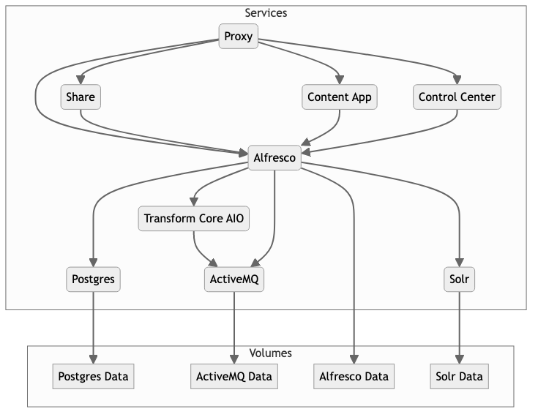
ActiveMQ - Community
Non-Containerized Deployment
Manual Installation (zip distribution)
Ansible Playbooks
Containerized Deployments
Docker Compose
Helm Charts (Kubernetes)
Repository produces messages when nodes are created / updated
Permission data is not included
Disable unless utilizing Out of Process SDK
Notes:
ActiveMQ is utilized differently in the community and enterprise versions of alfresco.
In this diagram of Community version, you can see how AMQ is leveraged by the Alfresco Repository and the Transform service.
The repository produces AMQ messages when a node is created, updated, or deleted.
*CLICK*
One thing to note is that permission data is not included in AMQ messages in Community.
*CLICK*
Since, AMQ messages are only consumed by the Out of Process SDK, it is considered a best practice to disable AMQ in your environment if you are not using the OOP SDK.

Slide 11
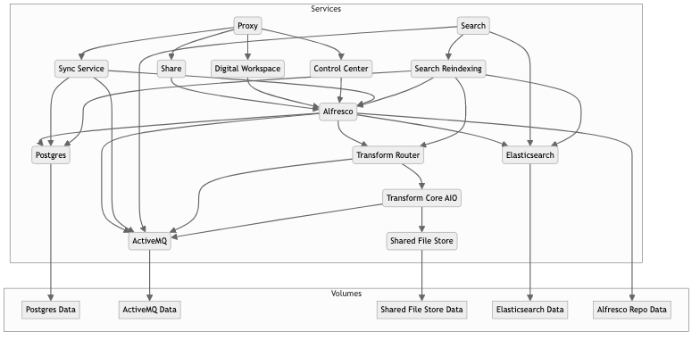
ActiveMQ - Enterprise
Non-Containerized Deployment
Manual Installation (zip distribution)
Ansible Playbooks
Containerized Deployments
Docker Compose
Helm Charts (Kubernetes)
Notes:
Now notice the difference with the Enterprise version of Alfresco. *CLICK*
As you can see more services are sending and consuming ActiveMQ messages.
Sync, Search, Transform and the Repository.
Let’s talk a little more about what else is different with the Enterprise version.

Slide 12
ActiveMQ - Enterprise
Non-Containerized Deployment
Manual Installation (zip distribution)
Ansible Playbooks
Containerized Deployments
Docker Compose
Helm Charts (Kubernetes)
Repository
Produces Node & Sync
Search
Produces / Consumes Transform
Sync
SDK
Consumes Sync
Topics
Repository
Queues
Sync
Search
Consumes Node changes
Produces / Consumes indexing & Transform
Transform
Transform
Produces / Consumes Transform
Notes:
Let’s talk about the difference in ActiveMQ messages in Enterprise.
First, you can see that as we discussed before, ActiveMQ is now being leveraged by many different services. Let’s break it down.
*CLICK* The Repository produces messages for node changes and sync services to topics, as well as producing and consuming messages to and from the transform service as queues.
*CLICK* The Sync service consumes sync message topics from the repository.
*CLICK* The Search enterprise consumes node events in order for Elasticsearch to index node changes and is also producing & consuming transform messages from queues.
*CLICK* The Transform service produces and consumes transform messages from queues.

Slide 13
ActiveMQ - Enterprise
Non-Containerized Deployment
Manual Installation (zip distribution)
Ansible Playbooks
Containerized Deployments
Docker Compose
Helm Charts (Kubernetes)
Permission Data
}
…
content":{"mimeType":"text/plain","sizeInBytes":5,"encoding":"UTF-8"},
"properties":{"cm:title":"","app:editInline":true,"cm:lastThumbnailModification":["pdf:1725455181598"],
"cm:description":""},
"localizedProperties":{"cm:title":{"en":""},
"cm:description":{"en":""}},
"aspectNames":["cm:thumbnailModification","cm:titled","app:inlineeditable","rn:renditioned","cm:auditable"],
"primaryAssocQName":"cm:sdfdf",
"secondaryParents":[],
"isFile":true,
"isFolder":false},
"resourceBefore":{"@type":"NodeResource","aspectNames":["app:inlineeditable","cm:thumbnailModification","cm:titled","cm:auditable"]},
"resourceReaderAuthorities":["GROUP_EVERYONE"],
"resourceDeniedAuthorities":[]
}
}
Includes permission data regarding the file
Notes:
One more thing to note about Enterprise version’s AMQ messages is that they include Permission data that stipulates who does and does not have access to the content node. As depicted here in the sample message, the resourceReaderAuthorities and resourceDeniedAuthorities properties will show what groups are affected.

Slide 14

Notes:
Perform activity 1

Slide 15
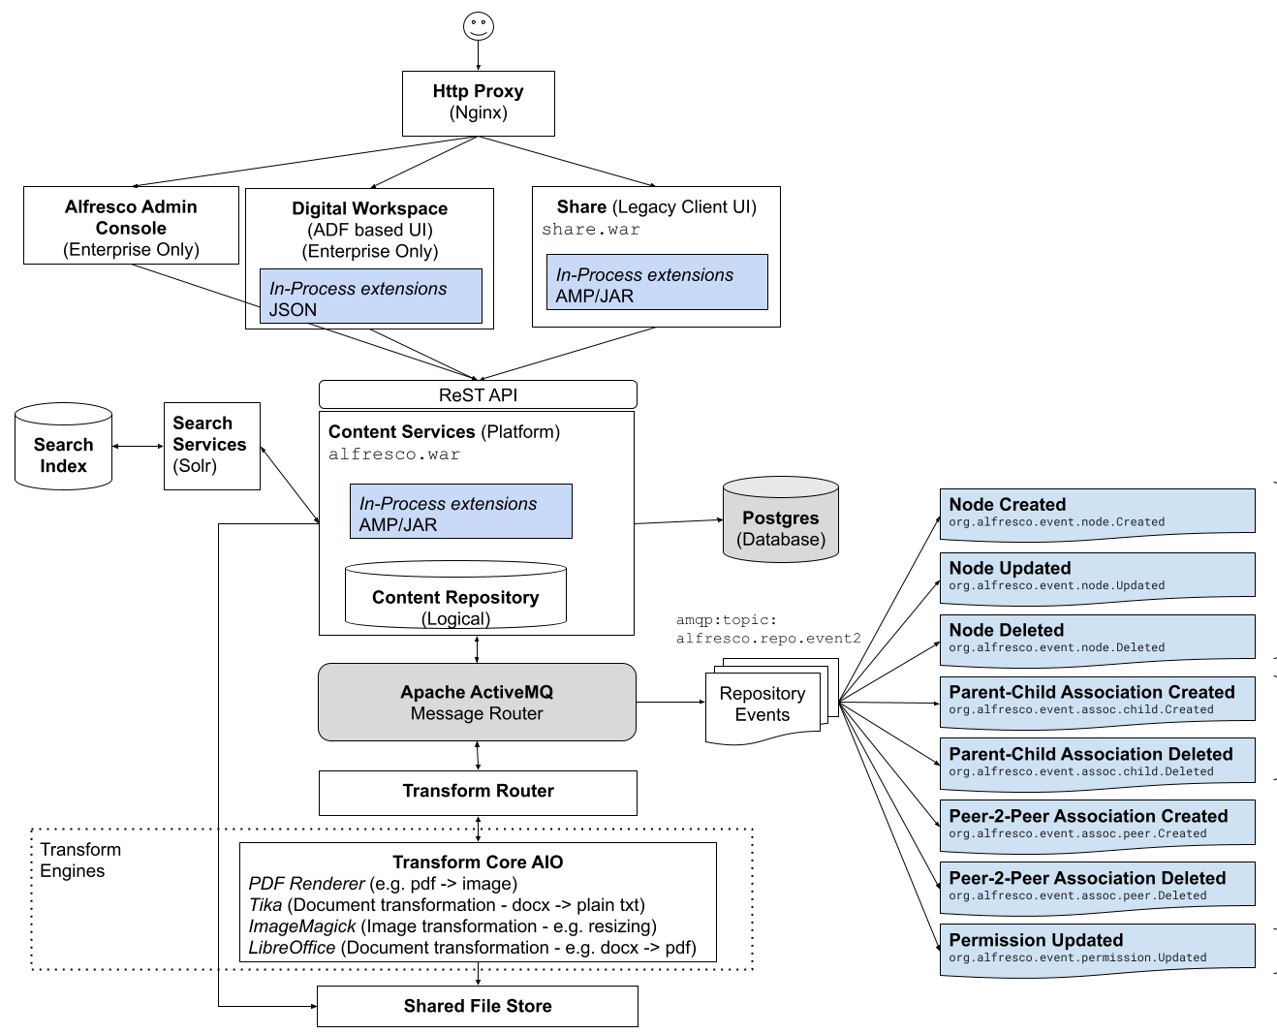
Activity 1 Summary
Established Out-of-Process template
Listening to messages from repository:
NodeCreated class
Logging (EventGenericTransformer)
Platform to implement IntegrationFlow.
https://docs.spring.io/spring-integration/reference/overview.html
Notes:
So, let’s summarize what we accomplished in these activities:
*CLICK* We’ve created an out-of-process Java skeleton / template, which will allow you to implement custom logic and perform actions within the repository.
*CLICK* We have classes listening to when nodes are created.
*CLICK* Further, we’ve created a platform by which we could integrate an IntegrationFlow, which gives you the power to filter messages based on content or type, or even squelch specific content in ActiveMQ messages and only forward the data you want to send.
More information can be found at the following link:
https://docs.spring.io/spring-integration/reference/overview.html

Slide 16
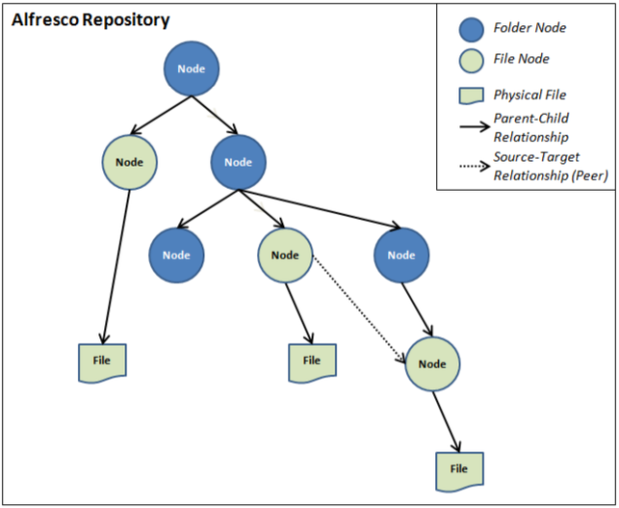
Event Model – Repository Structure
Non-Containerized Deployment
Manual Installation (zip distribution)
Ansible Playbooks
Containerized Deployments
Docker Compose
Helm Charts (Kubernetes)
Files and folders are referred to as nodes
Nodes can contain other nodes:
Parent–Child relationship
Nodes can be associated with other nodes:
Peer-to-peer relationship
Nodes in a store exist in a hierarchical relationship
Notes:
Before we dig into Event modelling, let’s first understand the nature of the repository file structure.
*CLICK* All the files and folders that are uploaded and created in the repository are referred to as nodes.
*CLICK* Some nodes, such as folders and rules, can contain other nodes (and are therefore known as container nodes).
*CLICK* Nodes can also be associated with other nodes in a peer to peer relationship, in a similar fashion to how an HTML file can reference an image file.
*CLICK* All nodes live in a Store, each store having a root node at the top, where nodes can reference specific files and / or contain nested child nodes, as shown in this diagram.

Slide 17
Event Model – Event Object (Cloud Events)
Property | Type | Description
type | String | The Alfresco event type. (1.0 spec#type)
specversion | String | The CloudEvents specification version. Value should be '1.0'. (1.0 spec#specversion)
id | String | Event ID, a UUID generated by the producer (1.0 spec#id)
source | URI-reference | The instance of a repository that produced the event, .i.e. repository cluster node identifier (1.0 spec#source)
time | Timestamp | The producer's timestamp of when the event occurred. (1.0 spec#time)
dataschema | URI-reference | Identifies the schema that data adheres to
datacontenttype | String | The content type of the data attribute. Value should be 'application/json'. (1.0 spec#datacontenttype)
data | JSON | The domain-specific data of the event. (1.0 spec#data)
data.eventGroupId | String | Optional unique identifier for events group, i.e. a transaction ID
data.resource | Object (varies) | The object representing the resource affected
data.resourceBefore | Object (varies) | The object representing the old values of the changed resource's attributes. Note, this object is only available on the Updated event type
extensionAttributes | Object (varies) | (Optional) The object representing extension attributes (if any) that can be additionally added to the event. Note, this object will not be serialized if it is null.
Event Object contains generic data about the node, id, type, source, time…
Data property holds information important necessary for logical operations
data.resource
data.resourceBefore
Can compare the data.resource and data.resourceBefore to determine content changes
Notes:
Now, let’s dig into event modelling. We’ll start with looking at the base Event Object which is based on the Cloud Events format. When capturing and analyzing an ActiveMQ message, you’ll be presented with this data model.
*CLICK* When utilizing the data model in an out-of-process application you’ll want to refer to the data property, as it contains the information you’ll rely upon to determine the details of the captured event.
*CLICK* For example: If you’re catching a node updated event you’ll be able to compare the data.resource and data.resourceBefore attributes in order to determine that the content of the node was edited.
(!) Add cloud events: https://github.com/cloudevents/spec/blob/v1.0/spec.md

Slide 18
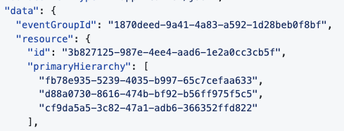
Event Model – Resource Object
Data.resource.primaryHierarchy contains the parent-child path to the file in the repository
event.getData().getResource();
Property | Type | Description
data.resource.id | String | The unique ID of the resource, i.e. a node ID
data.resource.primaryHierarchy | Array | Optional primary hierarchy of ancestors of the resource affected, i.e. folder path for content. Note that the first element is the immediate parent
Notes:
Next, we have the resource object contained within the data object.
The attribute to take note of is the primaryHierarchy, which contains an array of the parent nodes associated with this node, so essentially, a file path.
This information is primarily useful when attempting to determine what folders or sites the file may be contained in, or if a file was moved.

Slide 19
Event Model – Event Types
Event types consist of node events and association events.
Name | Description
org.alfresco.event.node.Created | Occurs when a node is created
org.alfresco.event.node.Updated | Occurs when a node is updated or moved. Currently only node's name, type, properties, aspects, and content are supported
org.alfresco.event.node.Deleted | Occurs when a node is deleted
org.alfresco.event.assoc.child.Created | Occurs when a secondary child association is created
org.alfresco.event.assoc.child.Deleted | Occurs when a secondary child association is deleted
org.alfresco.event.assoc.peer.Created | Occurs when a peer association is created
org.alfresco.event.assoc.peer.Deleted | Occurs when a peer association is deleted
Notes:
Next, let’s identify the possible event types that we can catch.
From the table you can see that there are node-specific events, and association-specific events.
So, we’re able to listen for events affecting a node specifically, as well as child and peer node events.

Slide 20
ACS Event Model
https://github.com/Alfresco/acs-event-model
Notes:
So, now that we understand the basics of the event object, let’s review each event type and discover the notable properties that you’ll need to know when leveraging them.
[ Launch Github page and review from there ]
https://github.com/Alfresco/acs-event-model

Slide 21
Notes:
Activity 3
[Start Delegate Workshop ]

Slide 22
Activity 3 Summary
Listening to messages from repository:
NodeUpdated class
Performing actions within the repository
Creating comment on node
Notes:
Again, let’s summarize what we accomplished in this activity:
*CLICK* We’ve extended our out-of-process project to include a class that is listening for Node Updated repository messages.
*CLICK* Further, we’ve applied conditional logic that filters node updates that were edited by users other than the node’s creator and applied a comment to that node.

Slide 23
Alex Madon
Debug ActiveMQ messages using an out-of-process python platform
Notes:
That’s the end of my segment. It was a pleasure bringing this information to you and I hope you found it useful.
Next, Alex Mahdon will deliver the final segment of our session and show us how we may debug ActiveMQ messages using an out-of-process python platform.

Slide 24
QUESTIONS?
Notes:
[.THIS IS THE LAST SLIDE IN THIS PRESENTATION ]
Are there any questions?

